Slide 1
Master thesis topics proposals
Eurecat – Technology Centre of Catalonia

Slide 2
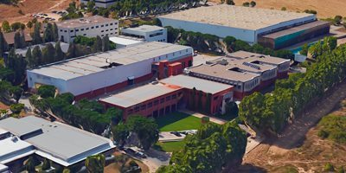
Master thesis topics proposals
Eurecat
What is Eurecat
Eurecat is the main technology center in Catalonia, providing cutting-edge R&D, technology services, and innovation to companies across multiple sectors.
Advanced Manufacturing Systems Unit
This unit focuses on the development of innovative manufacturing technologies, including additive manufacturing, hybrid processes, digitalization, robotics, and intelligent control systems.
Cerdanyola del Vallès site
All thesis projects will be carried out at Eurecat’s facilities in Cerdanyola del Vallès, located within the UAB Research Park. The site hosts pilot plants, laboratories, and multidisciplinary teams working on industrial research and technology transfer.
Av. Universitat Autònoma, 23, 08290 Cerdanyola del Vallès, Barcelona

Slide 3
Master thesis topics proposals
Research areas in AMS
Digital manufacturing
Projects focused on advanced manufacturing processes such as 3D printing, hybrid manufacturing (FFF + CNC), 5-axis toolpath generation, and digital twins. These topics aim to improve process efficiency, precision, and automation through simulation, control, and software development.
Machines and instrumentation
Projects related to the design and development of new equipment and monitoring systems for additive manufacturing. Topics include powder drying systems, low-cost sensors, and real-time monitoring platforms for process control and predictive maintenance.
Energy and materials
Projects exploring the interaction between materials and energy in manufacturing processes. This includes the design of acoustic metamaterials, the use of high-power ultrasound for fiber alignment, and the development of systems for microwave-based material processing.

Slide 4
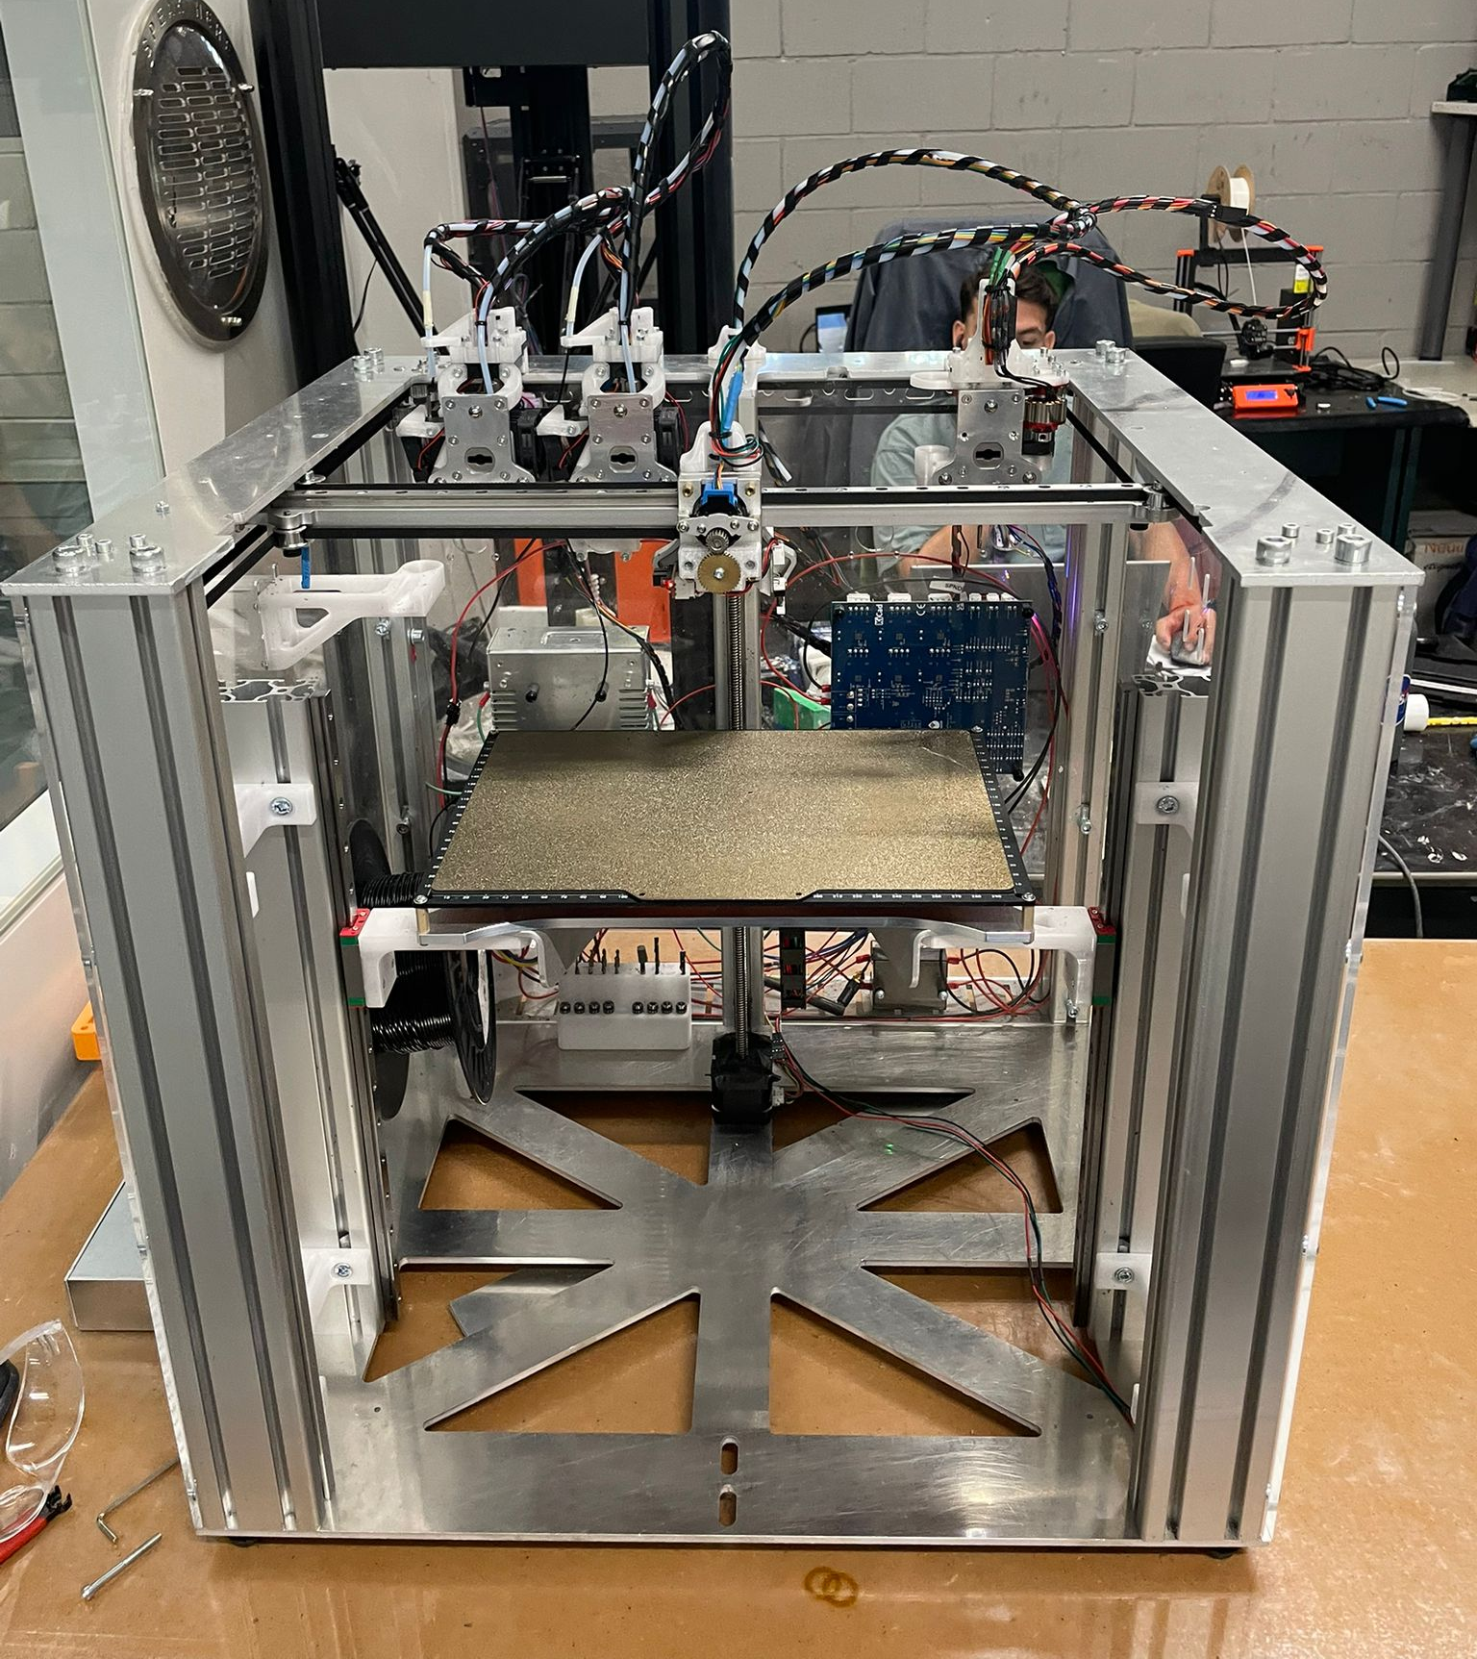
Master thesis topics proposals
Digital manufacturing
Development of a methodology to determine optimal process parameters for 3D printing and subsequent machining of parts
Objective: Develop a systematic methodology to identify and optimize the best process parameters for manufacturing parts using 3D printing and then machining them, according to the material and application requirements.
Context: The project will use Eurecat’s hybrid machine (FFF + CNC), which combines additive and subtractive processes on a single platform. The goal is to define a workflow that ensures high dimensional accuracy and surface quality.
Work plan
Familiarize with the current hybrid system and its control.
Analyze material properties and define relevant parameters for both 3D printing and machining.
Design and execute experiments to evaluate combinations of parameters.
Establish guidelines for selecting optimal process windows for different materials.
Expected outcome: A validated methodology for hybrid manufacturing that improves part quality and reduces trial-and-error in process setup.

Slide 5
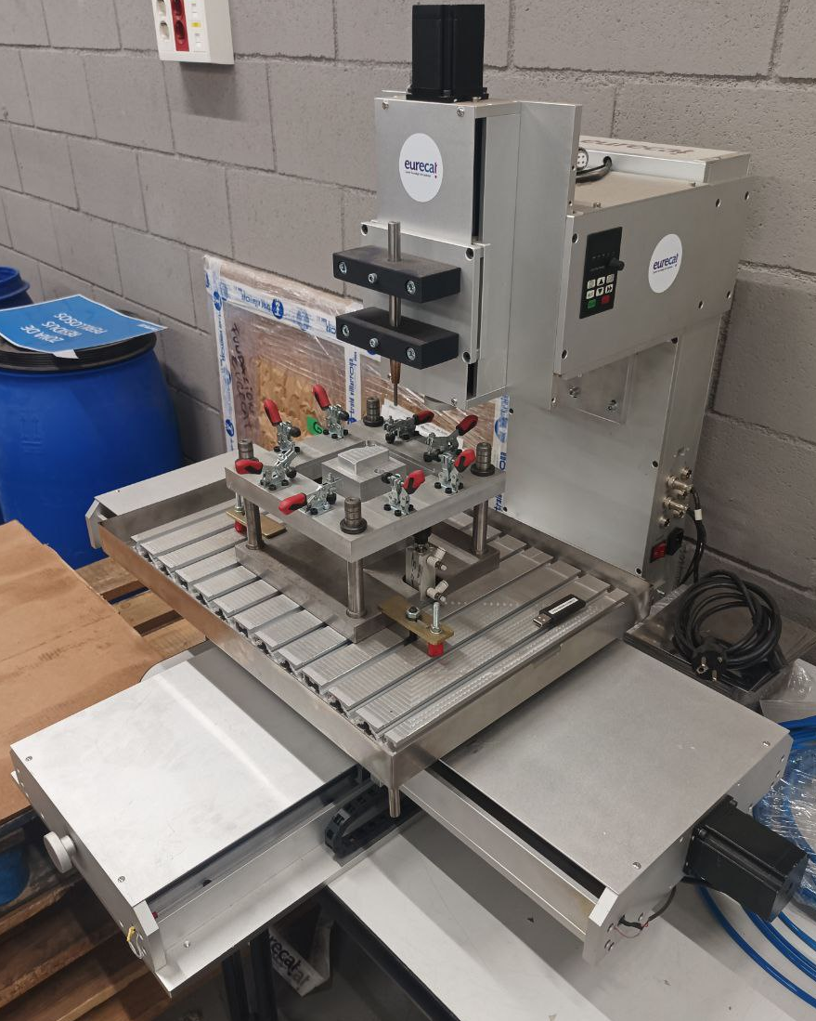
Master thesis topics proposals
Digital manufacturing
Development of an ISF system for biocompatible plastics
Objective: Commission and validate an Incremental Sheet Forming (ISF) system designed for biocompatible plastics, ensuring its functionality and suitability for sensitive materials.
Context: The machine has already been developed and is available at Eurecat, but requires commissioning, parameter definition, and experimental validation to become fully operational.
Work plan
Familiarize with the ISF system and its control architecture.
Configure the machine and define process parameters for biocompatible plastics.
Adapt components and tooling to handle sensitive materials.
Perform experimental trials and analyze limitations of the technology and machine.
Expected outcome: A fully operational ISF platform for research, prototyping, and small-scale production in biomedical and advanced material applications.

Slide 6
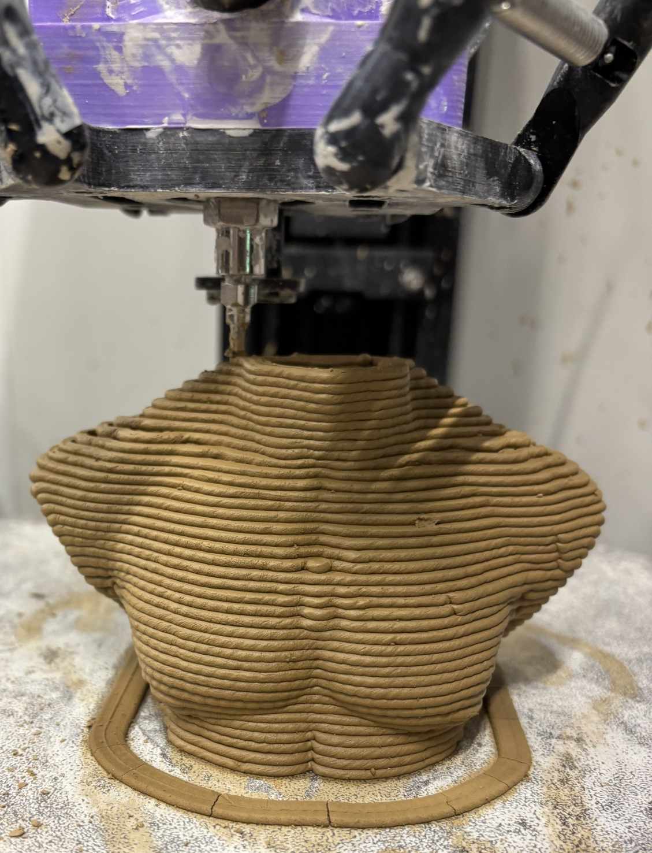
Master thesis topics proposals
Digital manufacturing
Methodology for determining optimal parameters in 3D Printing with pastes
Objective: Develop a methodology to define the best material mixture (water and aggregates or base material) and process parameters for 3D-printed parts, considering design constraints and their impact on kiln firing.
Context: Components are formed by extrusion and undergo thermal treatment. The workflow must ensure dimensional stability, mechanical strength, and defect-free surfaces by analyzing how material composition interacts with design and process variables during drying and firing.
Work plan
Familiarize with the current system and its control.
Identify optimal material mixtures for different applications.
Assess how design and process parameters affect final properties.
Conduct experiments to validate combinations.
Define guidelines for selecting process windows.
Expected outcome: A validated methodology for material formulation and process optimization

Slide 7
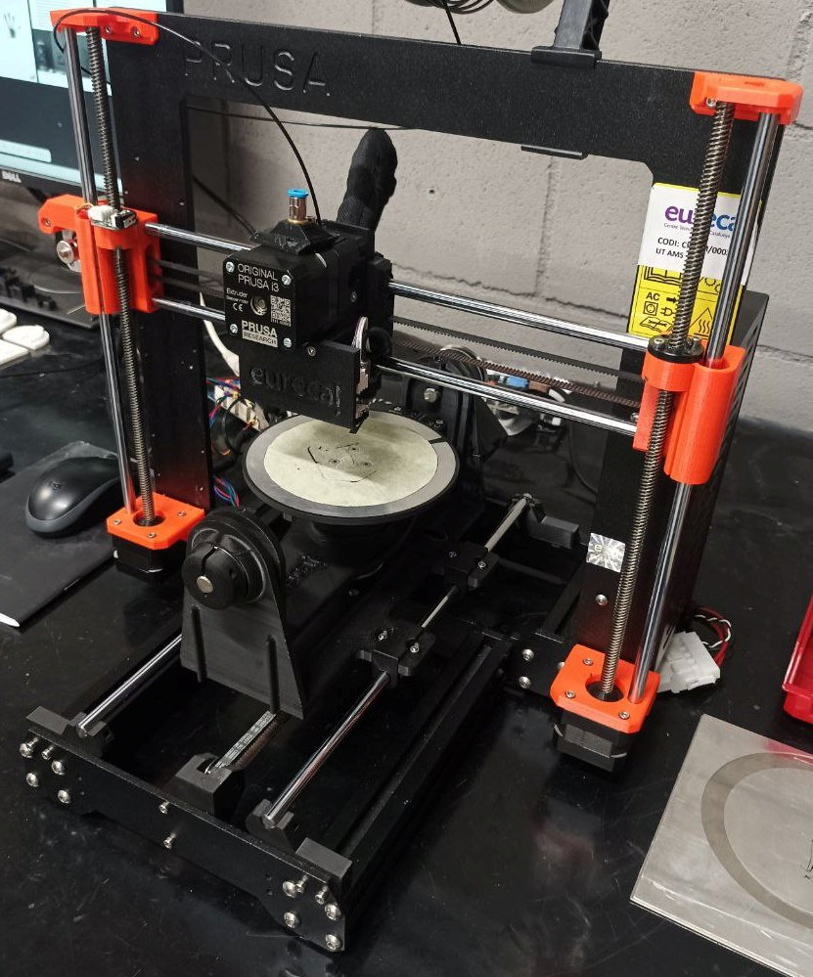
Master thesis topics proposals
Digital manufacturing
Development of a G-code generation script for 5-axis 3D printing
Objective: Develop and fine-tune a script for generating G-code for a 5-axis 3D printer using Grasshopper, based on the open-source Open5x project.
Context: The 5-axis printer is already operational at Eurecat. The script has been implemented but requires optimization to ensure smooth toolpaths and reliable execution. Additionally, the project aims to explore the limitations of the current setup and identify potential improvements.
Work plan
Familiarize with the existing 5-axis system and its control architecture.
Review and refine the Grasshopper-based script for G-code generation.
Test and validate toolpaths on complex geometries.
Analyze limitations of the current hardware and software configuration.
Propose improvements for future developments.
Expected outcome: A validated methodology for hybrid manufacturing that improves part quality and reduces trial-and-error in process setup.

Slide 8
Master thesis topics proposals
Digital manufacturing
Optimization of a 3D reconstruction model for additive manufacturing applications
Objective: Improve the performance and efficiency of the MapAnything deep learning architecture for 3D object reconstruction, focusing on speed and accuracy.
Context: Precise and fast 3D reconstruction is critical for quality control in additive manufacturing. Current models require optimization to meet industrial requirements.
Work plan
Familiarize with the existing MapAnything architecture and its data processing pipeline.
Analyze bottlenecks in inference time and reconstruction quality.
Implement improvements in model architecture and data handling.
Validate the optimized model using benchmark datasets and real manufacturing scenarios.
Expected outcome: A faster and more accurate 3D reconstruction system suitable for integration into additive manufacturing workflows.

Slide 9
Master thesis topics proposals
Machines and instrumentation
Design and development of a powder dryer for SLS technology
Objective: Design and build a system to remove moisture from polyamide (PA) powder used in Selective Laser Sintering (SLS) processes, improving material quality and process reliability.
Context: Humidity in PA powder significantly affects the performance and repeatability of SLS manufacturing. A dedicated drying system is required to ensure optimal conditions before processing.
Work plan
Familiarize with SLS technology and powder handling requirements.
Analyze environmental factors influencing powder humidity.
Design a drying system adapted to SLS process needs.
Manufacture a functional prototype and validate its performance in laboratory conditions.
Expected outcome: A reliable and efficient powder drying system that enhances SLS process stability and part quality.

Slide 10
Master thesis topics proposals
Machines and instrumentation
Design and validation of a low-cost tensiometer for industrial and research applications
Objective: Develop a low-cost tensiometer for continuous tension measurement in cables, wires, or lightweight structures, offering an affordable alternative to high-precision commercial systems.
Context
The solution aims to enable real-time monitoring in environments with limited budgets or pilot projects, using accessible technologies and easily manufacturable components.
Work plan
Review the state of the art and define functional requirements.
Design the device concept and select mechanical and electronic components.
Build a functional prototype and integrate data acquisition capabilities.
Validate the system experimentally to ensure technical and economic feasibility.
Expected outcome: A reliable and cost-effective tensiometer suitable for industrial and research applications.

Slide 11
Master thesis topics proposals
Energy and materials
Design and fabrication of vibroacoustic metamaterials using 3D printing
Objective: Develop vibroacoustic metamaterials capable of controlling sound and vibration propagation within specific frequency ranges, using additive manufacturing technologies.
Context: Metamaterials are periodic structures that exhibit unique acoustic properties. This project will leverage 3D printing to design and prototype these structures, enabling innovative solutions for noise and vibration control.
Work plan
Review the state of the art and select the target application and frequency range.
Design metamaterial structures using CAD tools and simulate their acoustic response with finite element analysis (COMSOL).
Manufacture prototypes using 3D printing technologies.
Validate performance experimentally, potentially in collaboration with external acoustic laboratories.
Expected outcome: Functional metamaterial prototypes with tailored acoustic properties for industrial or research applications.

Slide 12
Master thesis topics proposals
Energy and materials
Study of high-power ultrasound for fiber orientation in 3D printing
Objective: Investigate the use of high-frequency ultrasound to create standing wave fields capable of orienting fibers within composite materials during 3D printing.
Context:Ultrasound-assisted fiber alignment has great potential for producing advanced composite materials. However, high-power equipment (RF amplifiers at MHz range) is expensive and not currently available at Eurecat, which introduces technical challenges and risks.
Work plan
Review the state of the art and identify feasible applications and configurations.
Design an experimental setup including an ultrasound generator and integration with a 3D printer.
Evaluate options for using existing low-frequency equipment or low-cost MHz generators.
Manufacture test samples and characterize fiber orientation and mechanical properties.
Expected outcome: Proof of concept demonstrating the potential of ultrasound-assisted fiber alignment in additive manufacturing.

Slide 13
Master thesis topics proposals
Energy and materials
Automation of Metal Powder Dosing for Microwave Treatment
Objective: Develop an automated system for precise dosing of metal powders, including materials that are difficult to handle, for microwave treatment processes. The system must be electromagnetically compatible with the microwave environment and combine mechanical and electronic solutions to ensure process safety and efficiency.
Context: Microwave-based material processing requires controlled and safe dosing of metal powders, as electromagnetic fields can interfere with conventional mechanical and electronic components. This project aims to design a robust solution that enables accurate powder handling while minimizing risks and ensuring compatibility with microwave systems.
Work plan:
Define functional and safety requirements for the system.
Design the dosing mechanism (e.g., pneumatic or vibratory technology).
Select materials and components compatible with microwave environments.
Develop the electronic control system and integrate sensors for monitoring.
Manufacture a functional prototype and validate it experimentally under controlled conditions.
Expected outcome: A fully operational prototype that enables automated and safe dosing of metal powders for microwave processes.

